Slide 1
2014 WIEA Annual Conference Legendary Waters Resort & Casino April 11-12, 2014

Slide 2
Framing Self-Determination in the Era of Global Standards
South Central Comprehensive Center
June 10, 2015

Slide 3
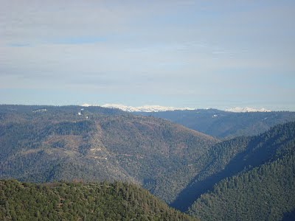
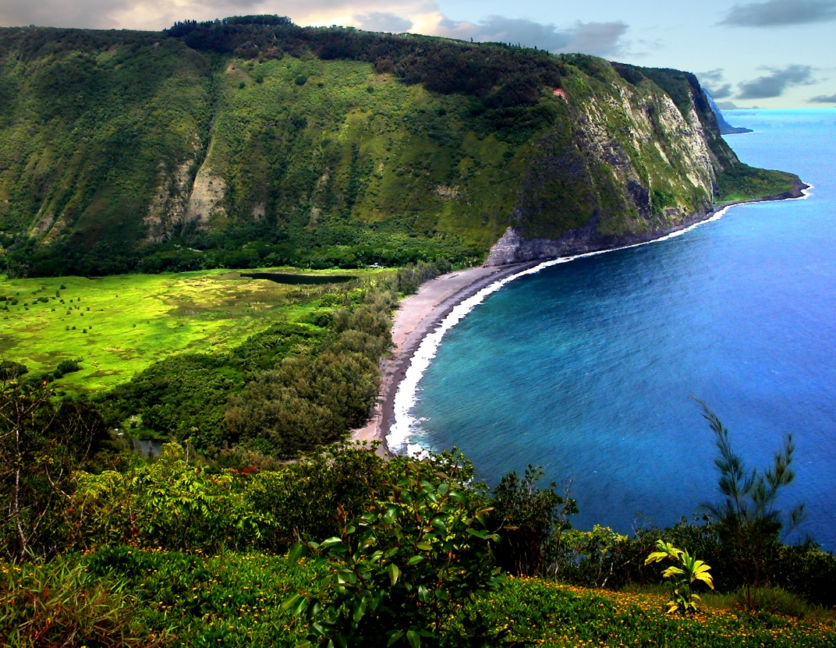
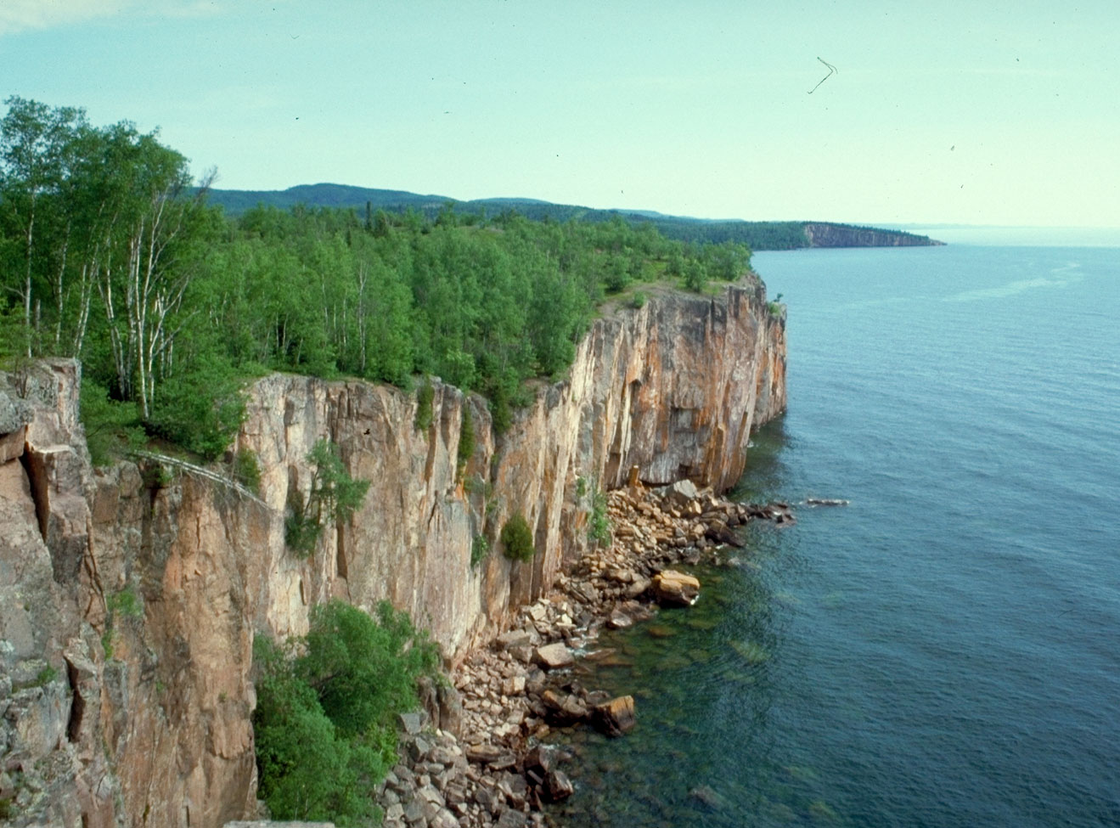
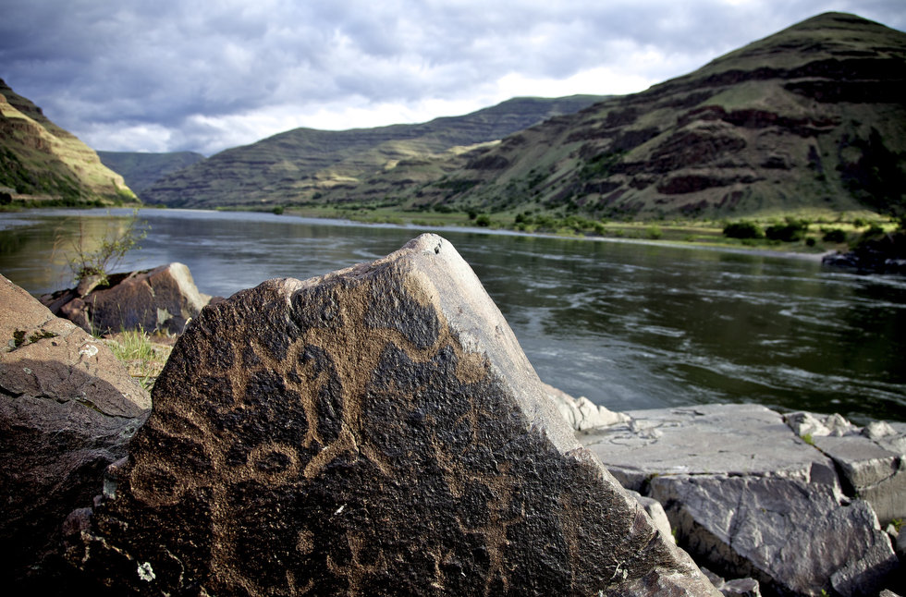

Slide 4
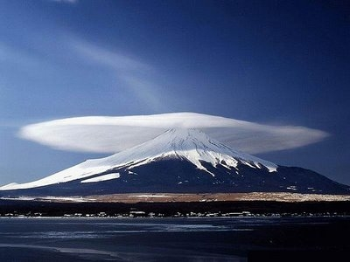
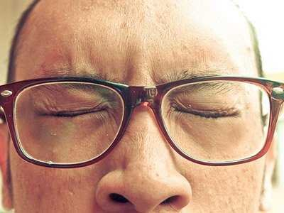
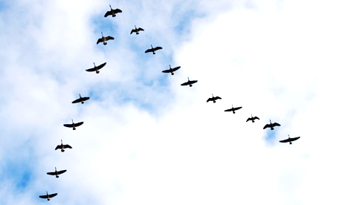
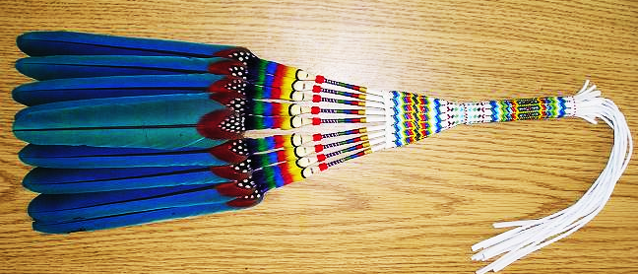

Slide 5
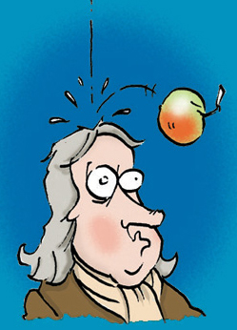
The 3 Laws

Slide 6
An object in motion…
The First Law
tends to stay in motion.

Slide 7
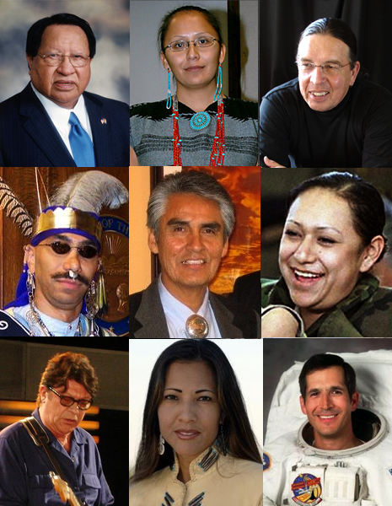
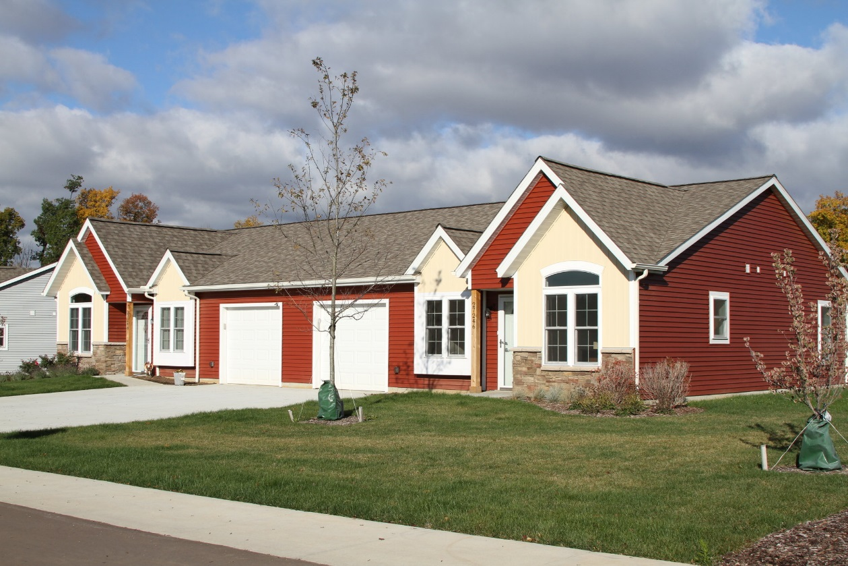
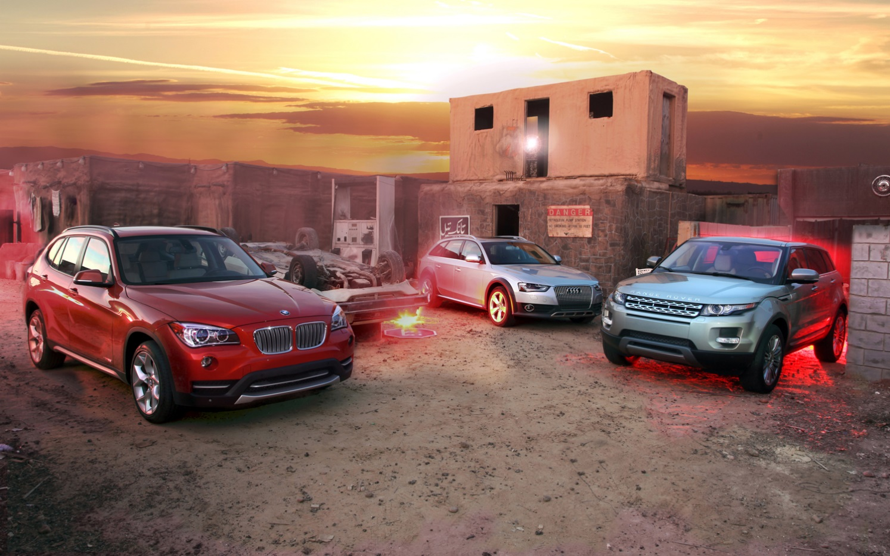

Slide 8
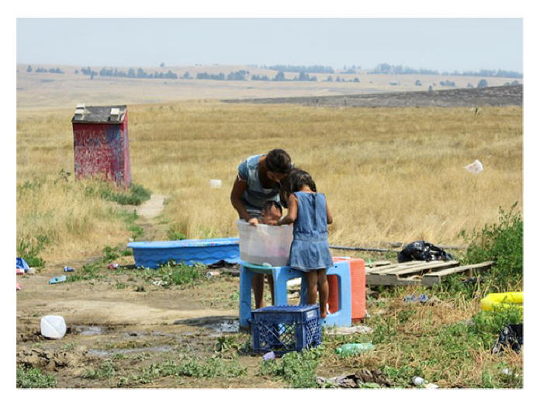
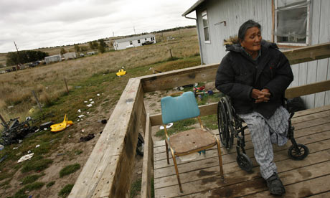
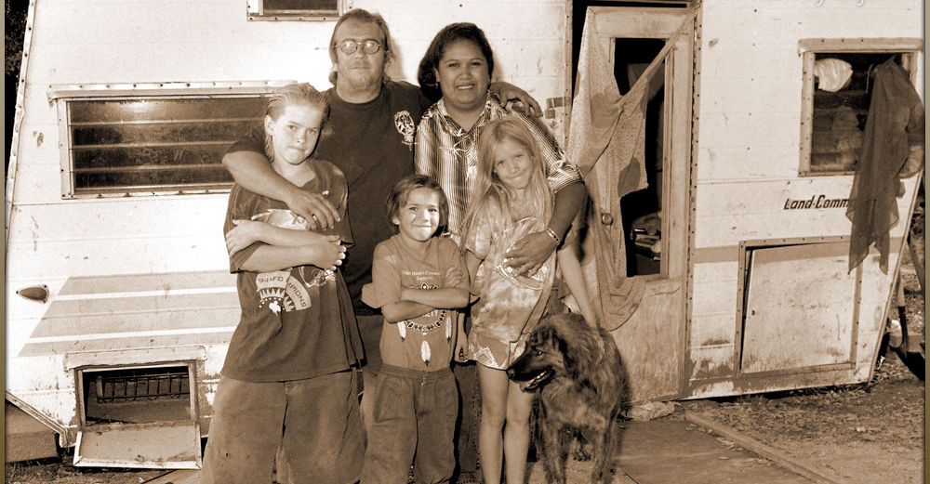

Slide 9
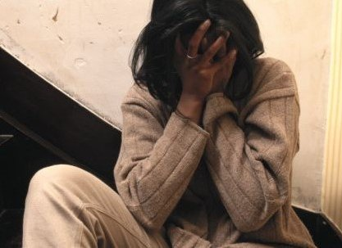
…the latter

Slide 10
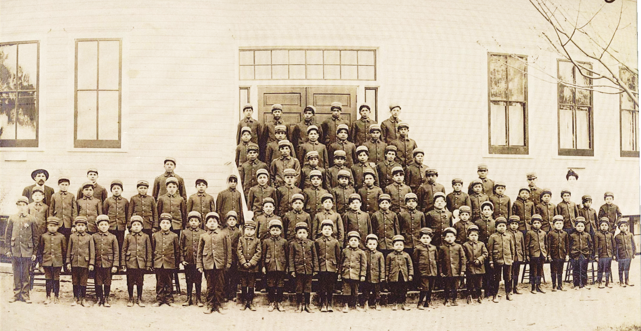
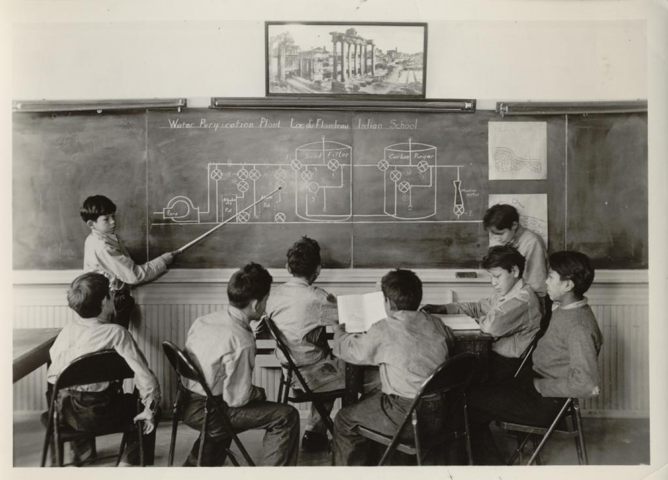

Slide 11
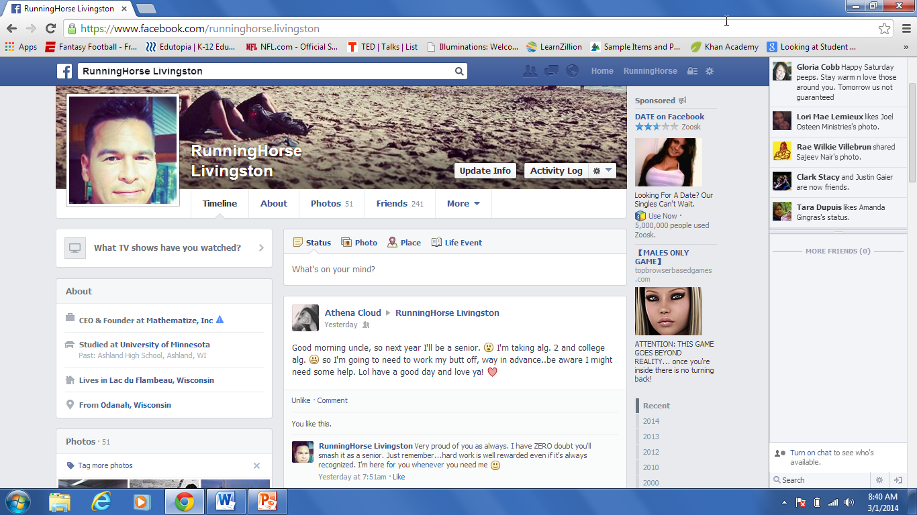
Manoominikwe
Chosa
Update Info
Activity Log
Born: August 28, 1873
Manoominikwe Chosa
Proud mother of one son!
Son’s name is Anakwad
Manoomin and wiiyaas for din din tonight. Yum!
Lives in Lac du Flambeau, Wisconsin
From: Lac du Flambeau, Wisconsin
Manoominikwe Chosa

Slide 12
Manoominikwe Chosa
Sep5, 1895
Old Village looks soooo different with the big church there now
Like * Comment
Manoominikwe Chosa
Sep12, 1895
These logger dudes are getting on my last nerve! Ugh. They think they own the place!

Slide 13
Manoominikwe Chosa
Sep15, 1895
WTF…the IA came to our place with some county cops and took Anakwad!!! Freaking out. How can they do this??????
Like * Comment
Manoominikwe Chosa
Sep18, 1895
Been 3 days and NO ONE will tell us where our son is…this is like a really bad dream…
Like * Comment
Manoominikwe Chosa
Oct 2, 1895
We found him. He was just right down the road at that new school but they won’t let her leave! GIVE MY CHILD BACK!!!!

Slide 14
Manoominikwe Chosa
Oct 28, 1895
We don’t know whate else to do! We’ve talked to everyone we know and no one can do anything. My baby needs his parents!!
Like * Comment
Manoominikwe Chosa
Feb 4, 1896
If they would just let us be with him…even for a day. I would give ANYTHING. I would trade places with him in a heartbeat ☹
Like * Comment
Manoominikwe Chosa
Nov 18, 1896
Our lives our cold and empty. I hardly talk to my husband. Nothing matters anymore. I hate my life

Slide 15
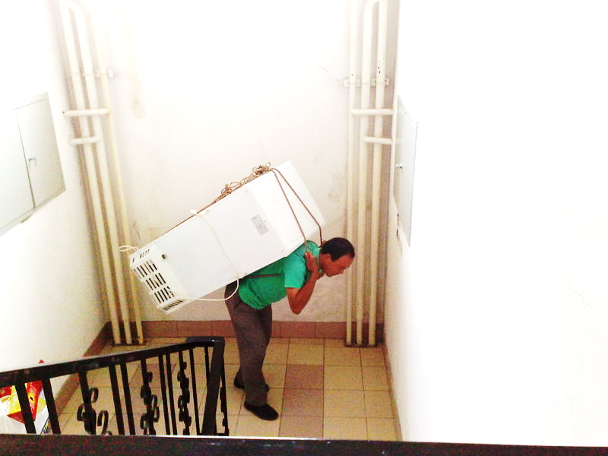
The Second Law
Larger + Heavier = More Force

Slide 17
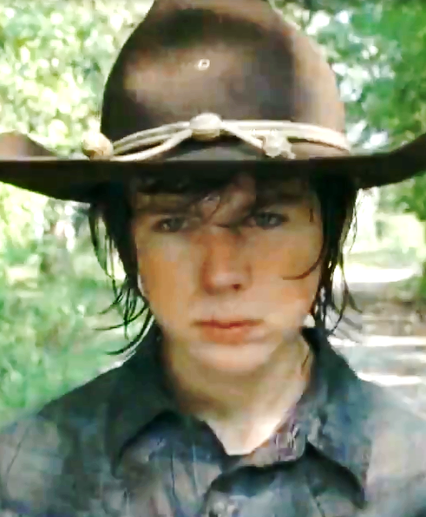
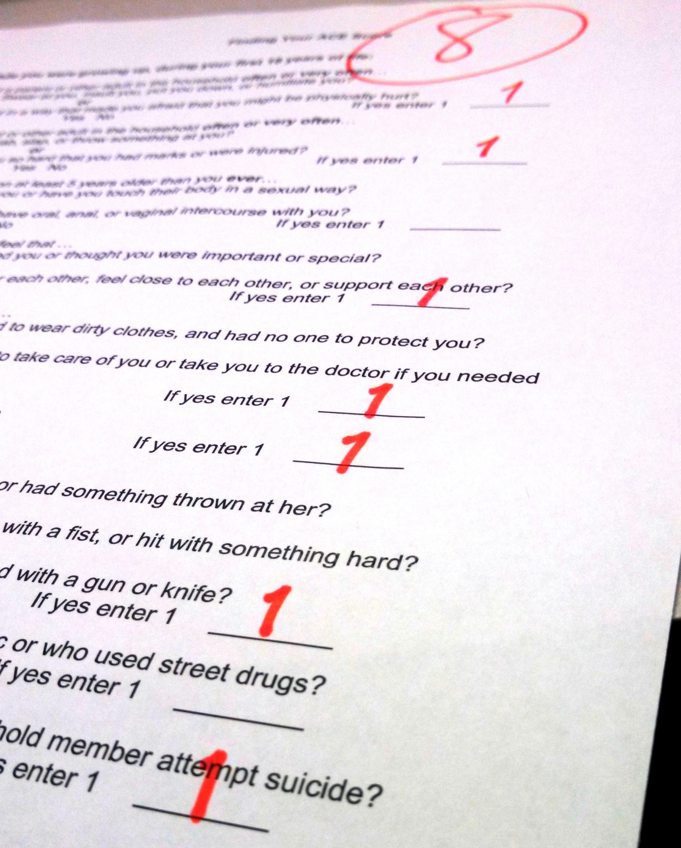
Adverse Childhood Experience (ACE) Score:
8

Slide 18
RTI
PBIS
Differentiation
Maslow
Culture of Poverty
Common Core
STEP
PLC’s
Responsive Classroom
Beyond Consequences
Conscious Discipline
Race to the Top
Smarter Balanced
The 4 C’s
ILP’s
Q-Comp
NCLB

Slide 19
“…when these periods of silence lasted at least 3 seconds, many positive things happened to students' and teachers' behaviors and attitudes.” Stahl, 1994
Wait Time

Slide 20
“Each hemisphere is indeed a conscious system in its own right, perceiving, thinking, remembering, reasoning, willing, and emoting.” Sperry, 1974
Split Brain

Slide 21
“A learning style is the accustomed pattern used to acquire information, concepts, and skills.” Appleton, 1983
Learning Style

Slide 22
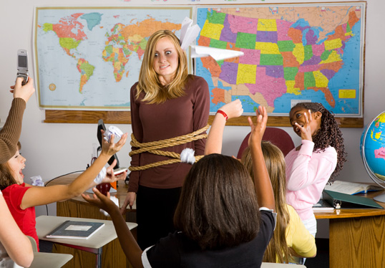

Slide 23
Go to kahoot.it on your device
Enter the game-pin shown on screen
Type in nickname
Press “Join Game”

Slide 24
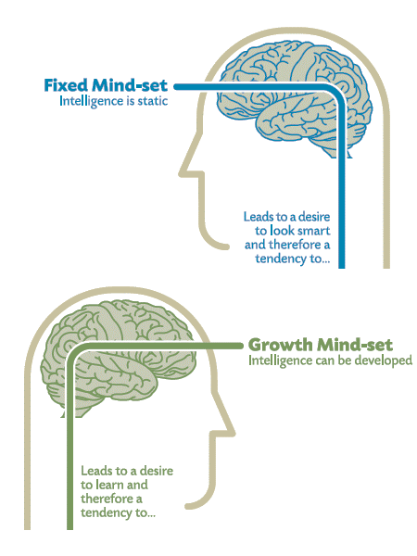

Slide 25
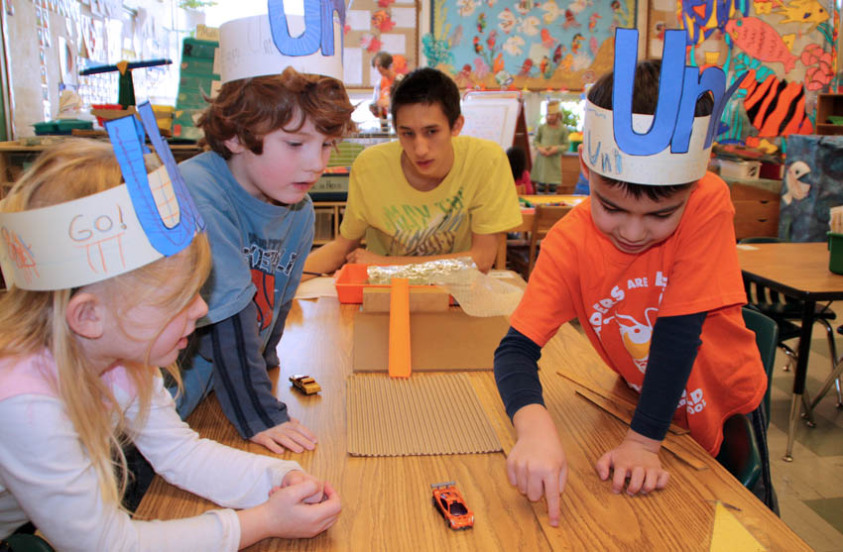
Creativity creates creativity

Slide 26
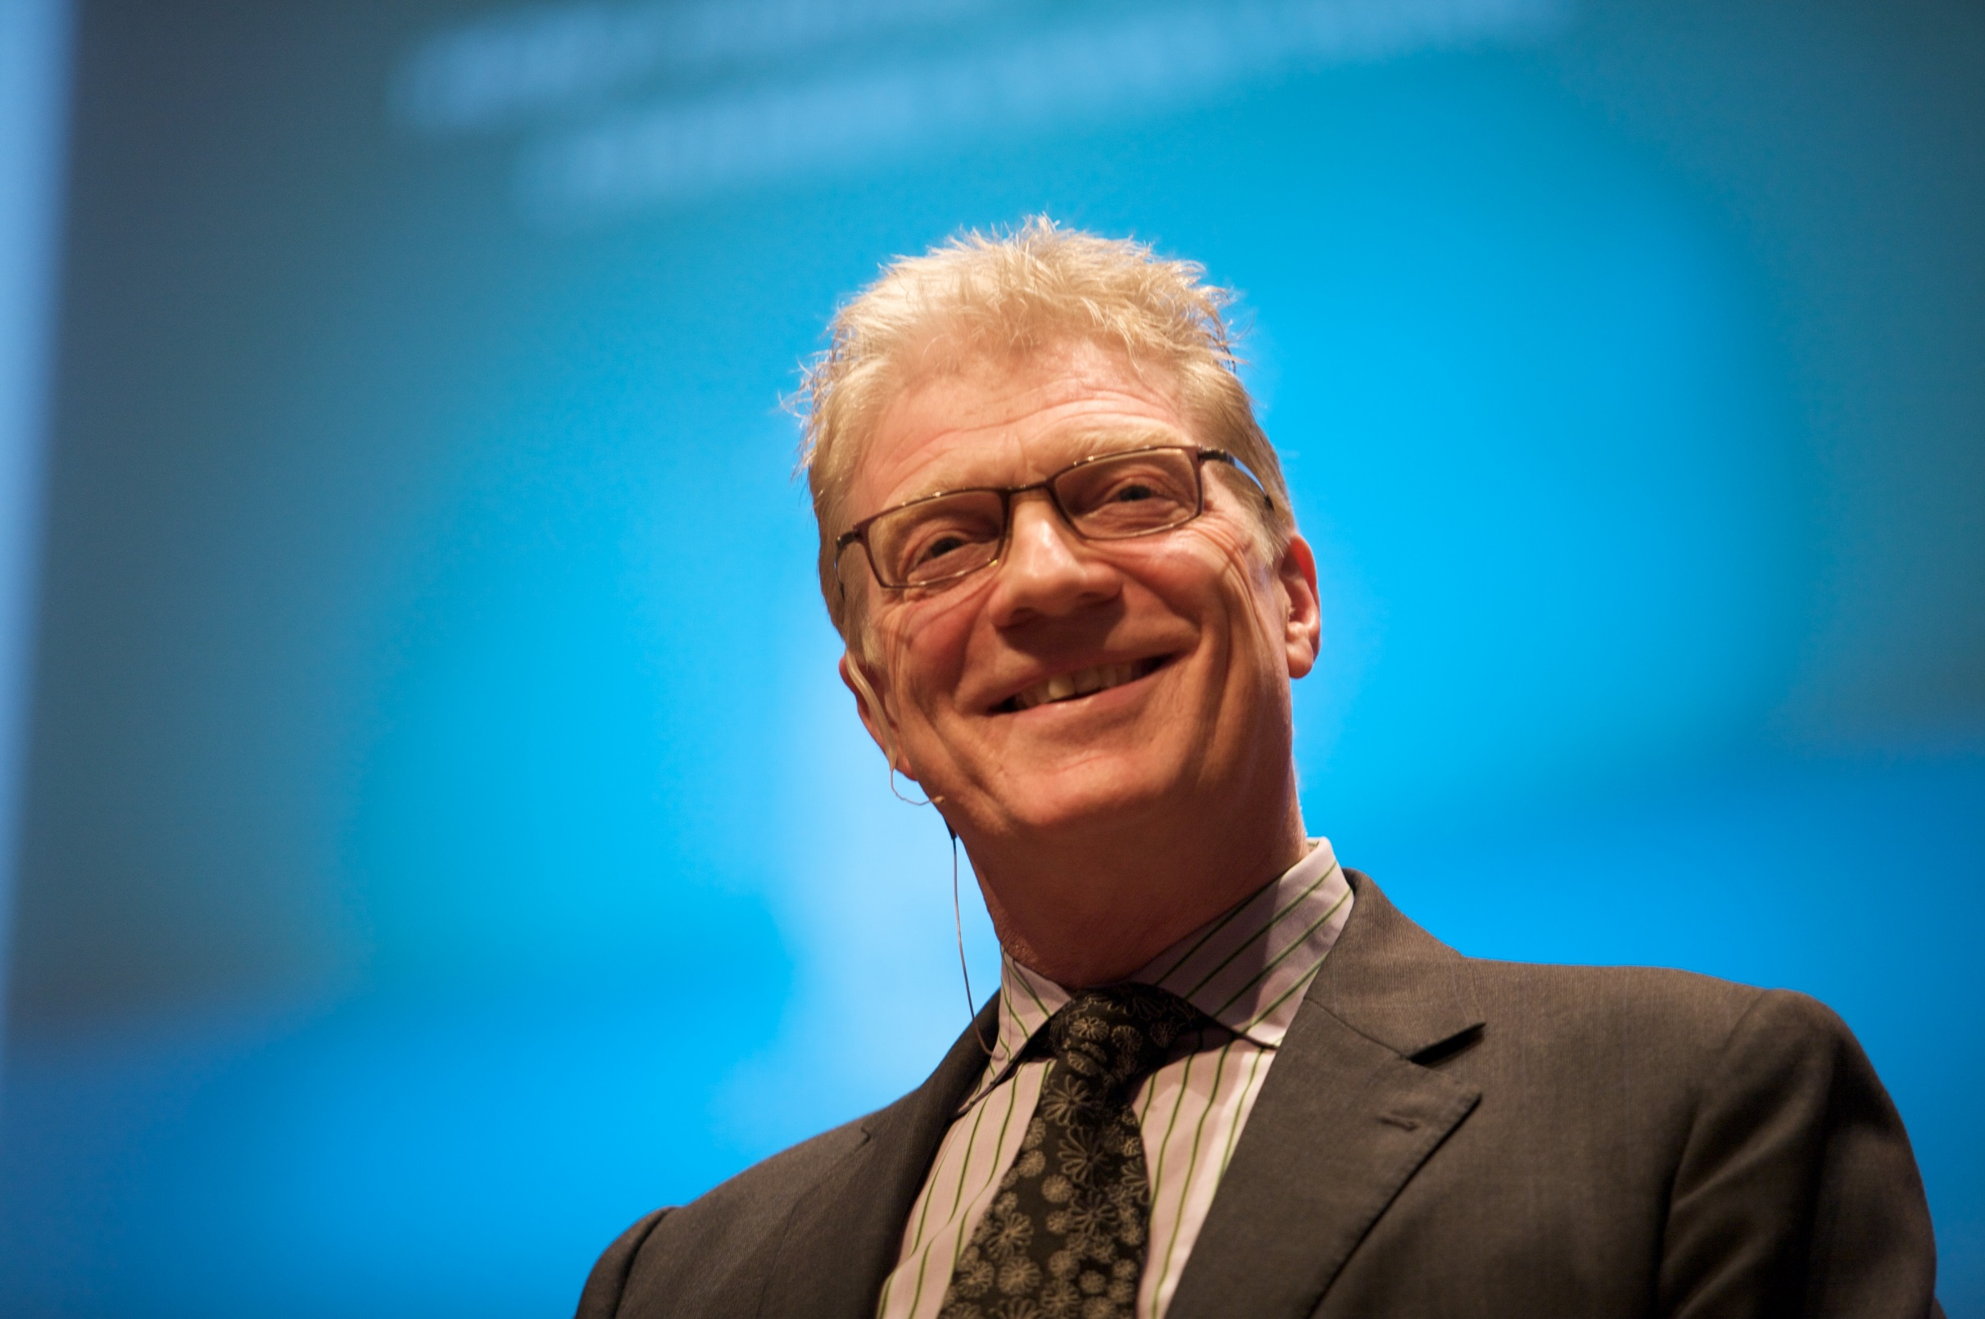
Sir Ken Robinson
Talks

Slide 27
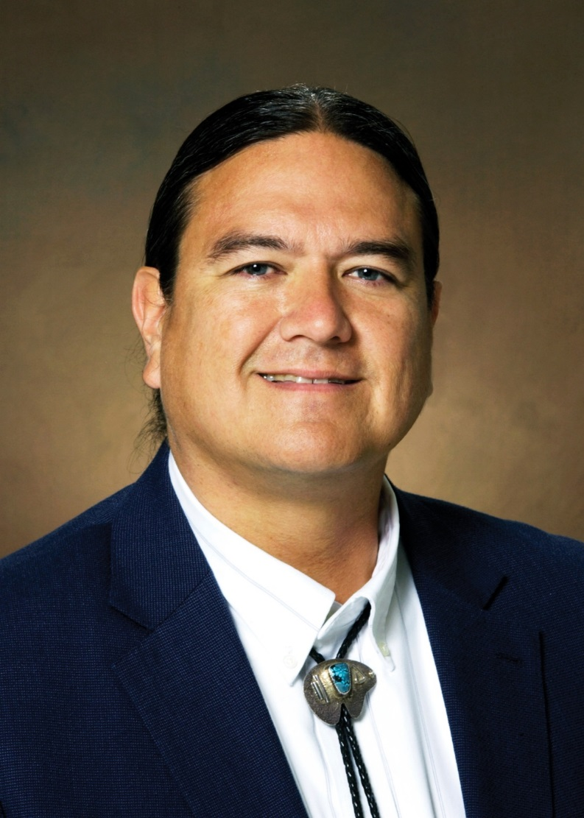

Slide 28
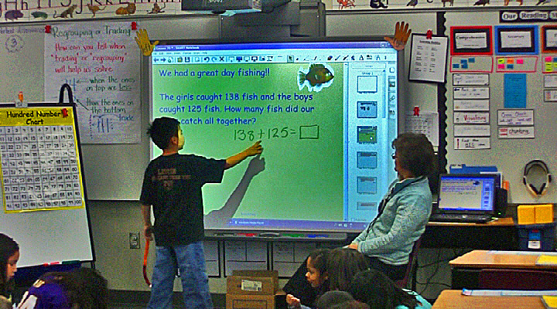
…nurturing creativity

Slide 29
138 + 125 = _____
263
258
250
230
200

Slide 30
Tower-Soudan School
28.8%
2011
91.3%
2012

Slide 31
For every action there is an equal and opposite reaction
The Third Law
karma

Slide 32
a prior action that takes into account or forestalls a later action
anticipation
[an-tis-uh-pey-shun]

Slide 33
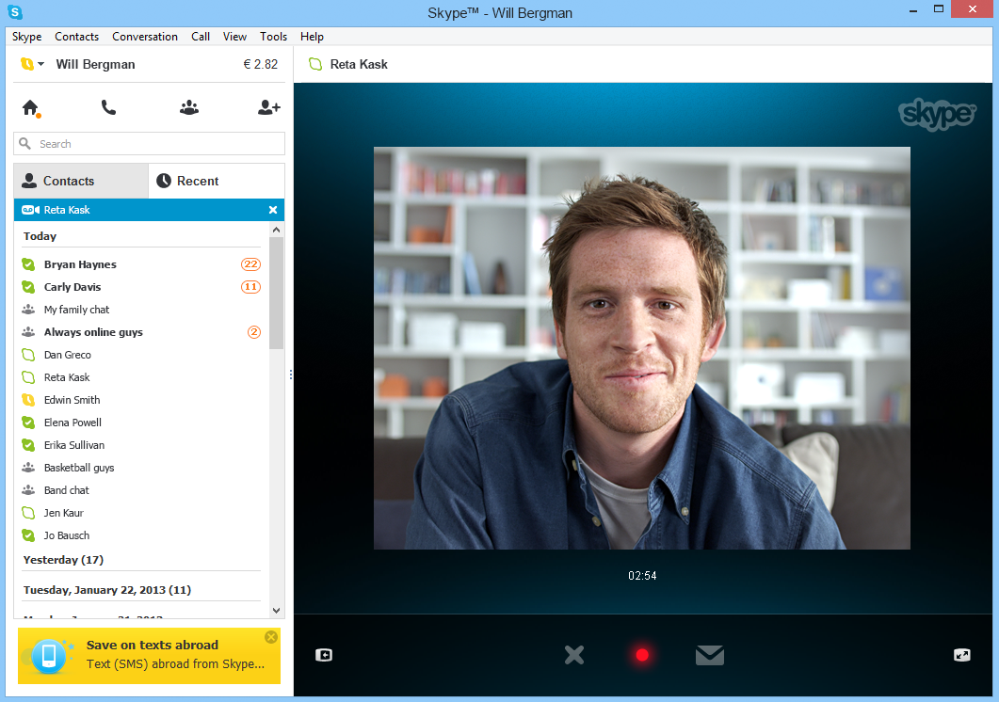
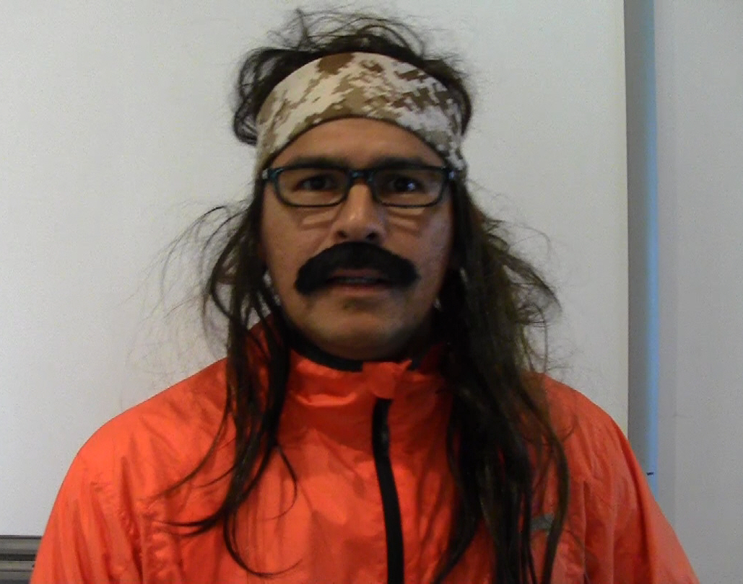
LIVE with Future RunningHorse Livingston

